Slide 1
Acts 11:1-18
1 The apostles and the brothers throughout Judea heard that the Gentiles also had received the word of God. 2 So when Peter went up to Jerusalem, the circumcised believers criticized him 3 and said, "You went into the house of uncircumcised men and ate with them." 4 Peter began and explained everything to them precisely as it had happened: 5 "I was in the city of Joppa praying, and in a trance I saw a vision. I saw something like a large sheet being let down from heaven by its four corners, and it came down to where I was.

Slide 2
Acts 11:1-18
6 I looked into it and saw four-footed animals of the earth, wild beasts, reptiles, and birds of the air. 7 Then I heard a voice telling me, 'Get up, Peter. Kill and eat.' 8 "I replied, 'Surely not, Lord! Nothing impure or unclean has ever entered my mouth.' 9 "The voice spoke from heaven a second time, 'Do not call anything impure that God has made clean.' 10This happened three times, and then it was all pulled up to heaven again. 11"Right then three men who had been sent to me from Caesarea stopped at the house where I was staying.

Slide 3
Acts 11:1-18
12The Spirit told me to have no hesitation about going with them. These six brothers also went with me, and we entered the man's house. 13He told us how he had seen an angel appear in his house and say, 'Send to Joppa for Simon who is called Peter. 14He will bring you a message through which you and all your household will be saved.' 15"As I began to speak, the Holy Spirit came on them as he had come on us at the beginning. 16Then I remembered what the Lord had said: 'John baptized with water, but you will be baptized with the Holy Spirit.'

Slide 4
Acts 11:1-18
17So if God gave them the same gift as he gave us, who believed in the Lord Jesus Christ, who was I to think that I could oppose God?" 18When they heard this, they had no further objections and praised God, saying, "So then, God has granted even the Gentiles repentance unto life."

Slide 5
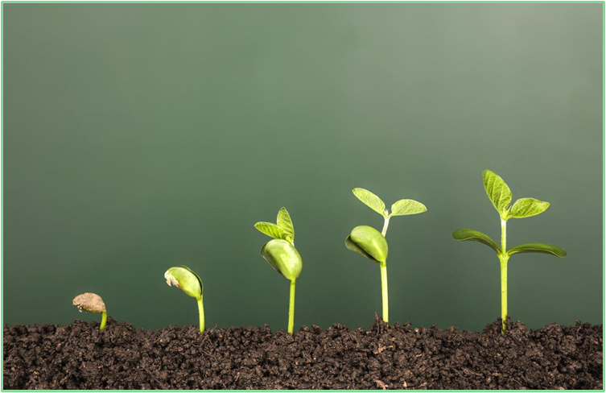
The Early Church Matures
Making the Church a place for all
June 19th

Slide 6
• JEWS – born Jews, Jewish heritage
• PROSELYTES – those who were not born Jews but converted to
become Jews – being circumcised (males) &
fulfilling the requirements of the Jewish law.
• GOD-FEARERS – Gentiles who believed in one God and accepted
the ethical standards of the Jewsish religion, &
attended synagogue services
• BELIEVERS - at this time, all the believers in the Jerusalem church,
including the apostles, were Jews!!
• GENTILES – anyone who was not a Jew.

Slide 7
Acts 1:8
… you will receive power when the Holy Spirit comes on you; and you will be my witnesses in Jerusalem, and in all Judea and Samaria,
and to the ends of the earth.”

Slide 8
Acts chapter 10
¹ At Caesarea there was a man named Cornelius, a centurion in what was known as the Italian Regiment.
² He and all his family were devout and
God-fearing; he gave generously to those in need and prayed to God regularly.
³ One day at about three in the afternoon he had a vision. He distinctly saw an angel of God, who came to him and said, “Cornelius!”

Slide 9
⁴ Cornelius stared at him in fear. “What is it, Lord?” he asked.
The angel answered, “Your prayers and gifts to the poor have come up as a memorial offering before God.
⁵ Now send men to Joppa to bring back a man named Simon who is called Peter.
⁶ He is staying with Simon the tanner, whose house is by the sea.”

Slide 10
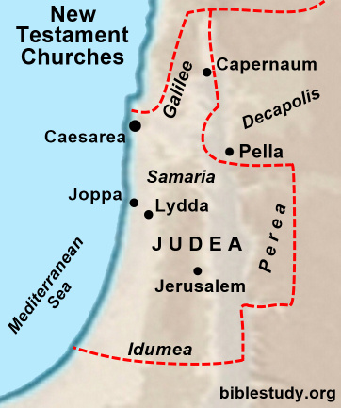
⁷ When the angel who spoke to
him had gone, Cornelius called
two of his servants and a devout
soldier who was one of his attendants.
⁸ He told them everything that had
happened and sent them to Joppa.

Slide 11
⁹ About noon the following day as they were on their journey and approaching the city,
Peter went up on the roof to pray.
¹⁰ He became hungry and wanted something to eat, and while the meal was being prepared, he fell into a trance.
¹¹ He saw heaven opened and something like a large sheet being let down to earth by its four corners. ¹² It contained all kinds of four-footed animals, as well as reptiles and birds.
¹³ Then a voice told him, “Get up, Peter. Kill and eat.”

Slide 12
¹⁴ “Surely not, Lord!” Peter replied. “I have never eaten anything impure or unclean.”
¹⁵ The voice spoke to him a second time,
“Do not call anything impure that God has made clean.”
¹⁶ This happened three times, and immediately the sheet was taken back to heaven.

Slide 13
¹⁷ While Peter was wondering about the meaning of the vision, the men sent by Cornelius found out where Simon’s house was and stopped at the gate. ¹⁸ They called out, asking if Simon who was known as Peter was staying there.
¹⁹ While Peter was still thinking about the vision, the Spirit said to him, “Simon, three men are looking for you. ²⁰ So get up and go downstairs. Do not hesitate to go with them, for I have sent them.”
²¹ Peter went down and said to the men, “I’m the one you’re looking for. Why have you come?”

Slide 14
²² The men replied, “We have come from Cornelius the centurion. He is a righteous and God-fearing man, who is respected by all the Jewish people. A holy angel told him to ask you to come to his house so that he could hear what you have to say.”
²³ Then Peter invited the men into the house to be his guests.
The next day Peter started out with them, and some of the believers from Joppa went along.

Slide 15
²⁴ The following day he arrived in Caesarea. Cornelius was expecting them and had called together his relatives and close friends.
²⁵ As Peter entered the house, Cornelius met him and fell at his feet in reverence.
²⁶ But Peter made him get up. “Stand up,” he said, “I am only a man myself.”
²⁷ While talking with him, Peter went inside and found a large gathering of people.

Slide 16
²⁸ He said to them: “You are well aware that it is against our law for a Jew to associate with or visit a Gentile.
But God has shown me that I should not call anyone impure or unclean.
²⁹ So when I was sent for, I came without raising any objection.
May I ask why you sent for me?”

Slide 17
³⁰ Cornelius answered:
“Three days ago I was in my house praying …
Suddenly a man in shining clothes stood before me ³¹ and said, …
³² Send to Joppa for Simon who is called Peter. … ³³ So I sent for you immediately, and it was good of you to come.
Now we are all here in the presence of God to listen to everything the Lord has commanded you to tell us.”

Slide 18
³⁴ Then Peter began to speak:
“I now realize how true it is that God does not show favoritism ³⁵ but accepts from every nation the one who fears him and does what is right.
³⁶ You know the message God sent to the people of Israel, announcing the good news of peace through Jesus Christ, who is Lord of all.
³⁹ “We are witnesses of everything he did in the country of the Jews and in Jerusalem. They killed him by hanging him on a cross, ⁴⁰ but God raised him from the dead on the third day and caused him to be seen.

Slide 19
⁴¹ He was not seen by all the people, but by witnesses whom God had already chosen—by us who ate and drank with him after he rose from the dead.
⁴² He commanded us to preach to the people and to testify that he is the one whom God appointed as judge of the living and the dead. ⁴³ All the prophets testify about him that everyone who believes in him
receives forgiveness of sins through his name.”

Slide 20
⁴⁴ While Peter was still speaking these words, the Holy Spirit came on all who heard the message. ⁴⁵ The circumcised believers who had come with Peter were astonished that the gift of the Holy Spirit had been poured out even on Gentiles. ⁴⁶ For they heard them speaking in tongues and praising God.
Then Peter said, ⁴⁷ “Surely no one can stand in the way of their being baptized with water. They have received the Holy Spirit just as we have.” ⁴⁸ So he ordered that they be
baptized in the name of Jesus Christ.
Then they asked Peter to stay with them for a few days.

Slide 21
Chapter 11 - 4 Hammer-blows of divine revelation to overcome the Jewish racial and religious prejudice against Gentiles:

Slide 22
Chapter 11 - 4 Hammer-blows of divine revelation to overcome the Jewish racial and religious prejudice against Gentiles:
• DIVINE VISION – to Peter; divine order and rebuke (3x)

Slide 23
Chapter 11 - 4 Hammer-blows of divine revelation to overcome the Jewish racial and religious prejudice against Gentiles:
• DIVINE VISION – to Peter; divine order and rebuke (3x)
• DIVINE COMMAND – to Peter, to go to Caesarea without hesitation

Slide 24
Chapter 11 - 4 Hammer-blows of divine revelation to overcome the Jewish racial and religious prejudice against Gentiles:
• DIVINE VISION – to Peter; divine order and rebuke (3x)
• DIVINE COMMAND – to Peter, to go to Caesarea without hesitation
• DIVINE PREPARATION – of Cornelius, to send for Peter

Slide 25
Chapter 11 - 4 Hammer-blows of divine revelation to overcome the Jewish racial and religious prejudice against Gentiles:
• DIVINE VISION – to Peter; divine order and rebuke (3x)
• DIVINE COMMAND – to Peter, to go to Caesarea without hesitation
• DIVINE PREPARATION – of Cornelius, to send for Peter
• DIVINE ACTION – clear baptism of the Holy Spirit

Slide 26
Chapter 11 - 4 Hammer-blows of divine revelation to overcome the Jewish racial and religious prejudice against Gentiles:
• DIVINE VISION – to Peter; divine order and rebuke (3x)
• DIVINE COMMAND – to Peter, to go to Caesarea without hesitation
• DIVINE PREPARATION – of Cornelius, to send for Peter
• DIVINE ACTION – clear baptism of the Holy Spirit
** Together they demonstrated conclusively that God had now
welcomed believing Gentiles into His family
on equal terms with believing Jews

Slide 27
Acts 11
¹ The apostles and the believers throughout Judea heard that the Gentiles also had received the word of God.
² So when Peter went up to Jerusalem, the circumcised believers criticized him ³ and said,
“You went into the house of uncircumcised men and ate with them.”

Slide 28
Acts 11
¹² The Spirit told me to have no hesitation about going with them.
These six brothers also went with me...
¹⁵ “As I began to speak, the Holy Spirit came on them as he had come on us at the beginning.
¹⁶ Then I remembered what the Lord had said: ‘John baptized with water, but you will be baptized with the Holy Spirit.’
¹⁷ So if God gave them the same gift he gave us who believed in the Lord Jesus Christ,
who was I to think that I could stand in God’s way?”

Slide 29
Acts 11
¹⁸ When they heard this, they had no further objections and praised God, saying,
“So then, even to Gentiles God has granted repentance that leads to life.”

Slide 30
350 000 MESSIANIC JEWS WORLDWIDE
(10 000 – 20 000 in Israel;
vast majority in U.S.)
2.2 BILLION CHRISTIANS WORLDWIDE

Slide 31
Genesis 12:1-3
The Lord had said to Abram,
“Go from your country, your people and your father’s household to the land I will show you.
² “I will make you into a great nation, and I will bless you; I will make your name great, and you will be a blessing. ³ I will bless those who bless you, and whoever curses you I will
curse; and all peoples on earth will be blessed through you.”

Slide 32
Isaiah 49:6
… a light for the Gentiles, that my salvation may reach to the ends of the earth.

Slide 33
God does not show favouritism
He wants the church to be a place for all

Slide 34
Acts 1:8
… you will receive power when the Holy Spirit comes on you; and you will be my witnesses in Jerusalem, and in all Judea and Samaria,
and to the ends of the earth.”

Slide 35
Acts 15
⁷ After much discussion, Peter got up and addressed them:
“Brothers, you know that some time ago God made a choice among you that the Gentiles might hear from my lips the message of the gospel and believe.
⁸ God, who knows the heart, showed that he accepted them by giving the Holy Spirit to them, just as he did to us.
⁹ He did not discriminate between us and them, for he purified their hearts by faith…
¹¹ … believe it is through the grace of our Lord Jesus that we are saved, just as they are.”
[Finally] James spoke up. “Brothers,” he said, “listen to me.
¹⁴ Simon has described to us how God first intervened to choose a people for his name from the Gentiles.

Slide 36
Galatians 3:8-27
⁸ Scripture foresaw that God would justify the Gentiles by faith, and announced the gospel in advance to Abraham: “All nations will be blessed through you.” 9 So those who rely on faith are blessed along with Abraham, the man of faith.
¹⁴ Christ redeemed us in order that the blessing given to Abraham might come to the Gentiles through Christ Jesus, so that by faith we might receive the promise of the Spirit…”…
²⁶ So in Christ Jesus you are all children of God through faith ...
²⁸ There is neither Jew nor Gentile, neither slave nor free, nor is there male and female, for you are all one in Christ Jesus.

Slide 37
Ephesians 2:12-19
¹² remember that … you were separate from Christ … without hope and without God in the world.
¹³ But now in Christ Jesus you who once were far away have been brought near by the blood of Christ.
¹⁴ For he himself is our peace, who has made the two groups one and has destroyed the barrier, the dividing wall of hostility,
…. His purpose was to create in himself one new humanity [the Church]
out of the two, thus making peace,
¹⁶ and to reconcile both [Jews and Gentiles] to God through the cross …
¹⁸ For through Jesus we both have access to the Father by one Spirit.
¹⁹ Consequently, you are no longer foreigners and strangers, but fellow citizens with God’s people and also members of his household.

Slide 38
Acts 4:12
Salvation is found in no one else,
for there is no other name
under heaven given to mankind
by which we must be saved.”

Slide 39
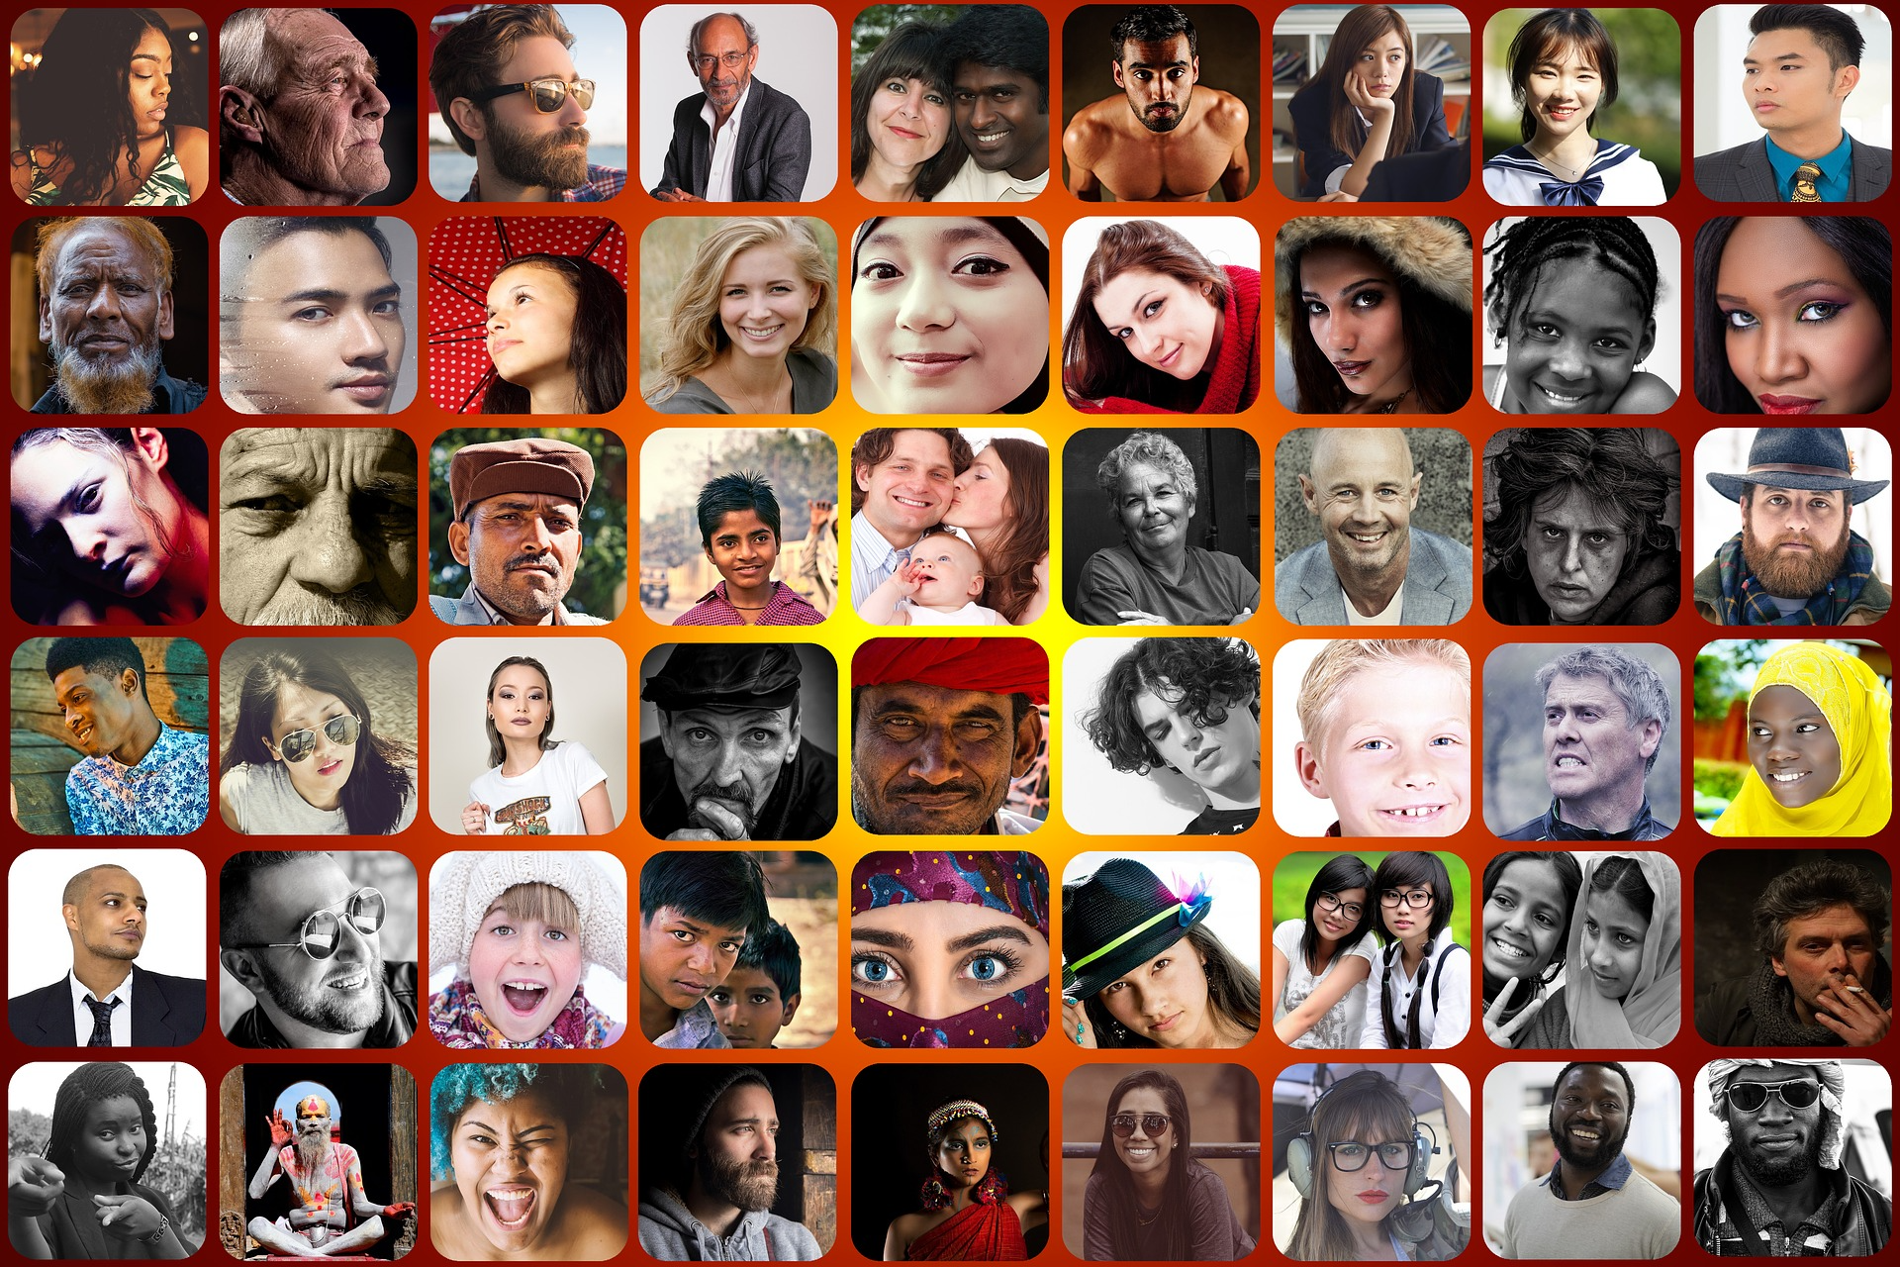
Do my attitudes & behavior
need to change?

Slide 40
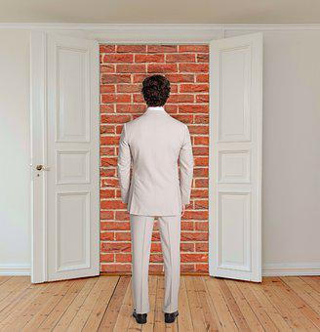
Am I putting obstacles in the way of
the church
being a place for all?

Slide 41
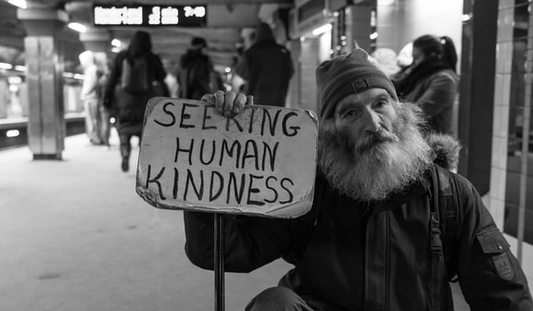
Photo by Matt Collamer on Unsplash

Slide 42
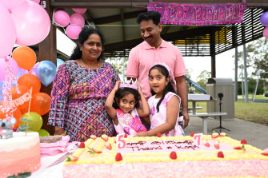

Slide 43
We will never change the world by going to church,
we will only change the world by being the church

